Slide 1


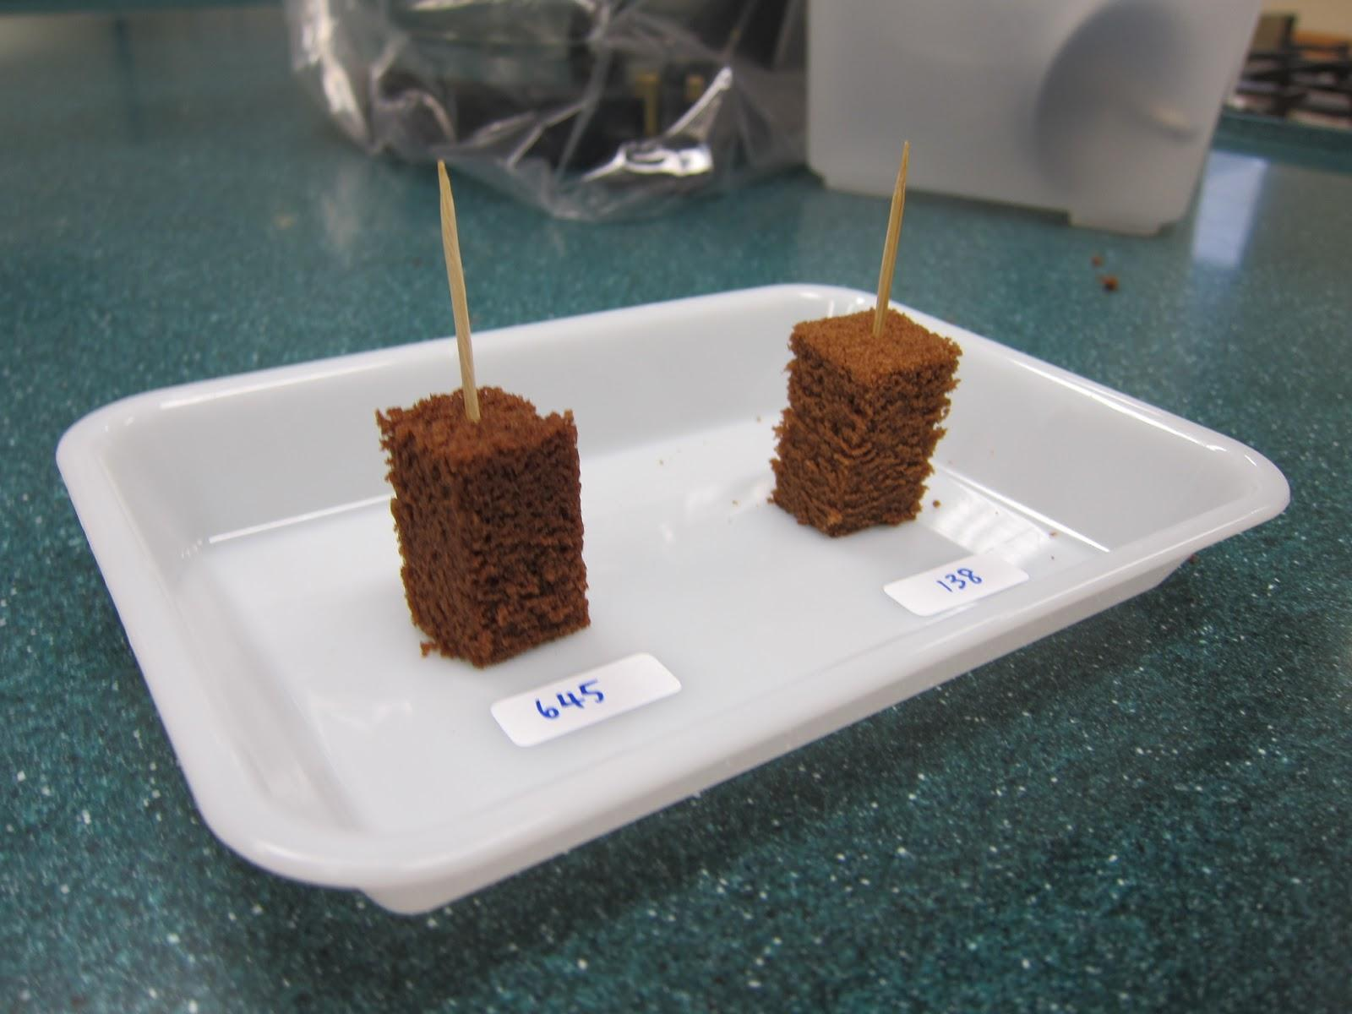
Sensory Evaluation
Helping food sciences with sensory evaluations panels by replacing manual data entry
Client: Dr. David Gee, CWU Health Sciences Department
Team WOW: Geoff Worley, Frank Senseney, Connor Taylor, Shaina Greer-Short
Supervisor: Dr. Szilárd Vajda
11/30/2017
Notes:
Frank

Slide 2

Table of Contents
The Client
Sensory Evaluation
Problem and Solution
Project Requirements
Design
Tools
Schedule
Conclusion
Notes:
Frank

Slide 3
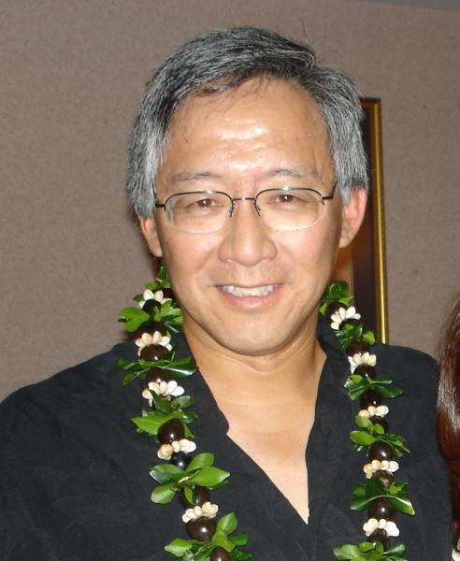
The Client
Dr. David Gee
CWU Health Sciences Department
Notes:
Frank

Slide 4

Sensory Evaluation
Measures human response
Studies consumer products
Analytical and Affective testing
Notes:
Frank

Slide 5

The Problem
Physical documents
Manual randomization
Manual transcription
Notes:
Frank

Slide 6
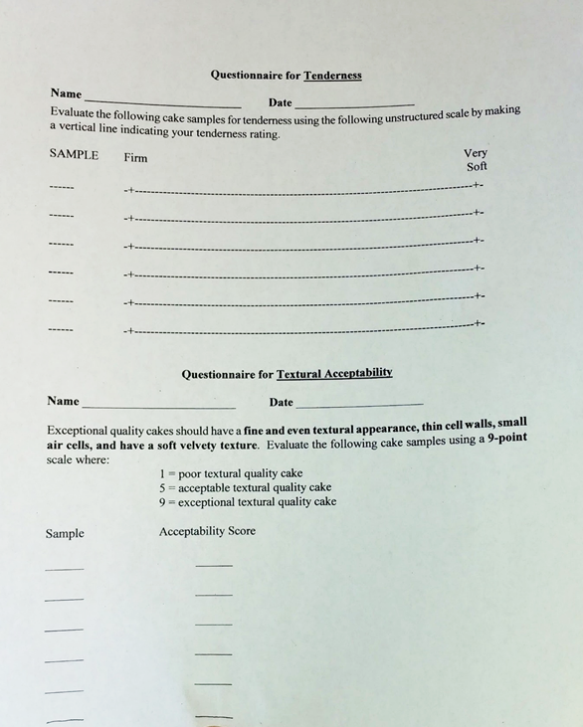

Slide 8

The Solution
Test creation
Data collection
Spreadsheet generation
Notes:
Connor

Slide 9
Project Requirements

Slide 10

Project Requirements
Users should be able to...
Log In
Create Tests
Store Test Data
Print Randomized Code
Input Data into Form
Save Judge Data
Export Excel
Notes:
Connor

Slide 11
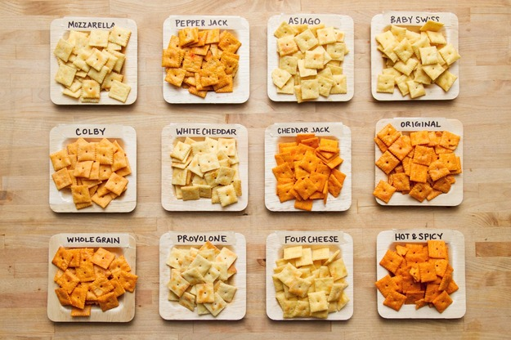
Create Test
Type of Test
Number of Judges
Number of Variables Tested
Type of Scale
Descriptive Terms
Notes:
Connor

Slide 12
Design

Slide 13
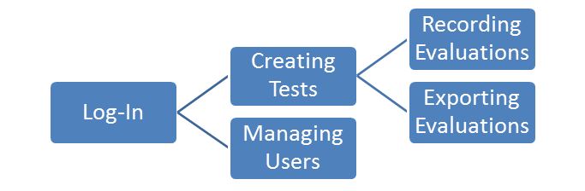
High level design
Notes:
Geoff
EDIT WITH FLOWCHART
Types of Users
Support Requirements
Tests/Evals/Users = DB Objects
Admin functions Vs. User functions
Permissions for tests

Slide 14

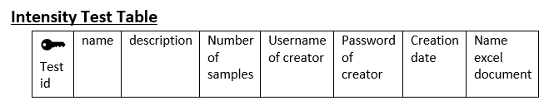
Database Setup
Test
Intensity Test
Attribute
Descriptive
Difference Test
Notes:
Geoff - This is just an option you can remove it if you would like we just need between 20 and 25 slides so we put this here
Create another slide giving more detail about the data contained in the database

Slide 15
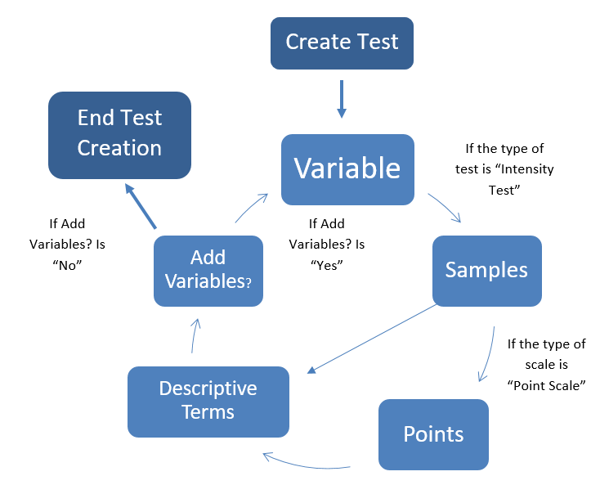
Test Setup
Notes:
Geoff - This is just an option you can remove it if you would like we just need between 20 and 25 slides so we put this here
Create another slide giving more detail about how the different aspects of creating a test interact

Slide 16
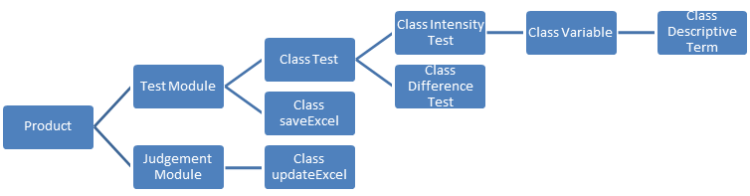
Low Level Design
Notes:
Geoff

Slide 17
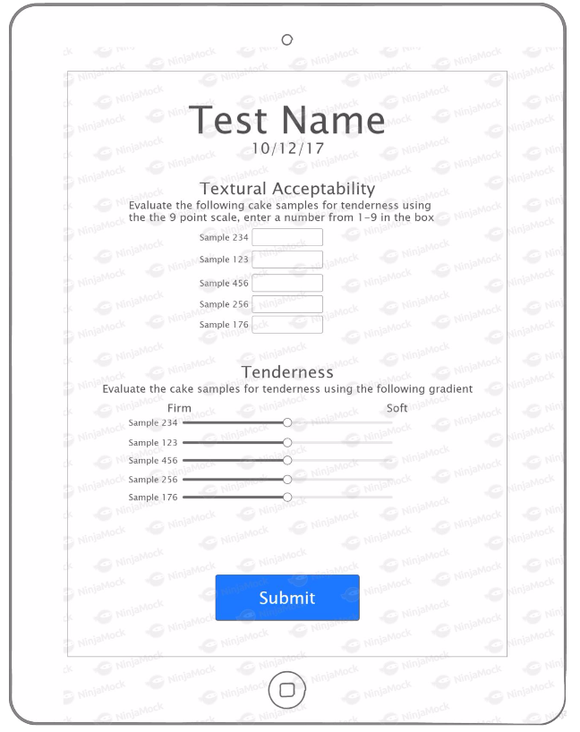
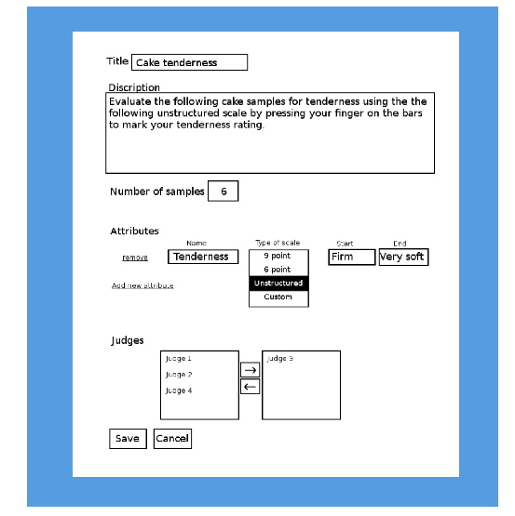
Interface Design
Notes:
Geoff

Slide 18
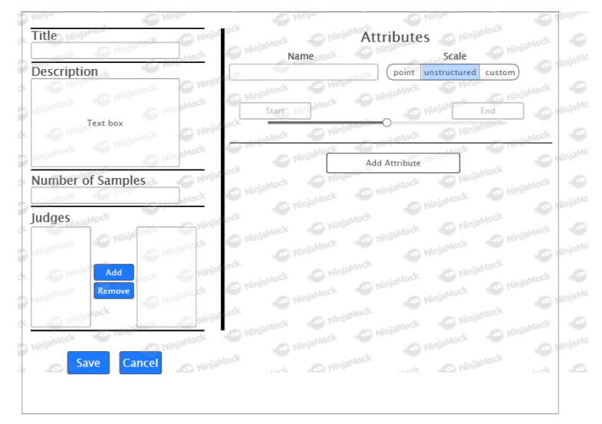
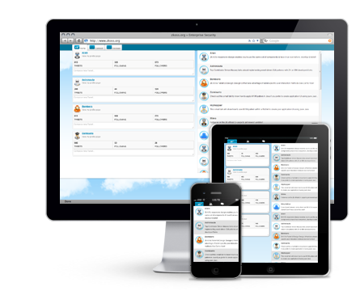
Interface Design
Notes:
Geoff

Slide 19







Tools
Version Control: Github
Communication: Slack
DB: mySQL
HTML, CSS, Javascript
PHP
Notes:
Shaina - I am going to take this Geoff because you have too many slides already and I don’t have enough

Slide 20
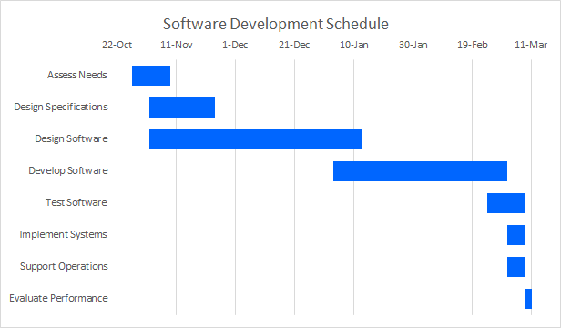
Notes:
Shaina

Slide 21
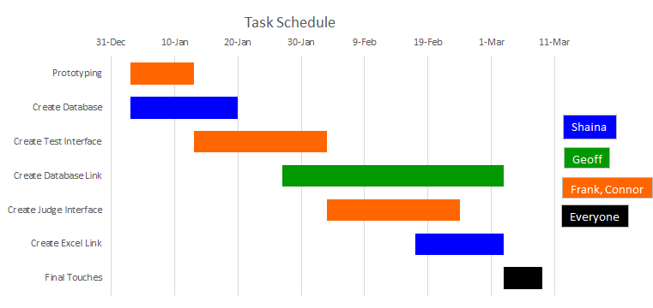
Notes:
Shaina

Slide 22
Conclusion
Problem
Solution
Requirements
Design
Tools
Schedule
Notes:
Shaina

Slide 23
Questions?
Notes:
Shaina

